Slide 1
Why Intersession?
presented to
Faculty Senate Executive Committee
January 23, 2013

Slide 2
Why intersession?
Benefits of intersession
Enrollment potential
Course offerings
Implications and implementation
Academic calendar
Notes:
Revenue distribution model – expect similar to summer (like other university centers) – Financials group developing

Slide 3
Some Benefits of Intersession
Opportunity to increase enrollment and revenue
Unique educational offerings that can focus on a single subject in small, intimate classes
Supports Finish in Four and improved graduation rates
More time between fall and spring for research, projects, and course preparation
Greater use of University facilities
Smoother spring semester start-up
Notes:
Revenue distribution model – expect similar to summer (like other university centers) – Financials group developing

Slide 4
Enrollment Potential
Assuming 3 credits per course and an average tuition rate of $300/credit would yield about $2M in tuition revenue for Stony Brook in 2012.

Slide 5
Course Offerings
Opportunity for innovative, engaging teaching and research
Intensive language study
Re-envisioned General Education courses
Capstone design experience
Distance learning
Internships
Study Abroad
Undergraduate research experiences
“Boot camps”
Immersion-style courses
Field research
The Academic Offerings sub-committee is developing recommendations, and is looking for participants.

Slide 6
Implications and Implementation
Committees assembled to explore implications and propose implementation plans
Academic Calendar and Faculty Advisory Group
Academic Offerings
Communications and Marketing
Financials
Records and Registration
University Services

Slide 7
Credit Hour Requirements
14 class days
Credits | 1 | 2 | 3 | 4 | 5
Contact hours per day | 55 minutes | 1 hour, 50 minutes | 2 hours, 45 minutes | 3 hours, 40 minutes | 4 hours, 30 minutes
Outside student preparation expected per day | 2 hours, 10 minutes | 4 hours, 20 minutes | 6 hours, 30 minutes | 8 hours, 40 minutes | 10 hours, 50 minutes
Additional contact hours may be substituted for preparation hours, but not vice versa.

Slide 8
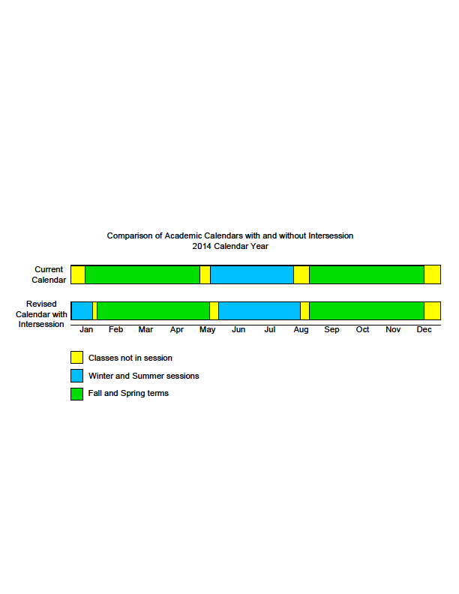
Impact on Academic Calendar
Comparison of Academic Calendars
with and without Intersession
2014 Calendar Year
Notes:
Discuss:
Keep fall
Move spring to allow for 3 week January intersession – 14 days
Spring starts 4th week in January, ends approx. 9 days later than current
Commencement May 16 - 23
Keep summer 12 weeks by reducing breaks and shifting start/end

Slide 9
Questions

